Slide 1
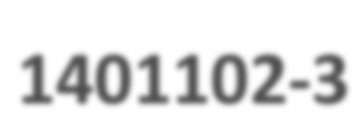

+
1401102-­‐3
Computer Programming
Fall 2021
Lecturer: Dr. Hatim Alsuwat
All Lecture notes represent a slightly edited version from lecture notes written by Dr. Abdulbaset Gaddah and Malak Aljabri

Slide 2
+
Outline
Why Java?!
Java features.
Java Program Structure
Good Programming Practice
Modifying Your First Java Program
Data Types & Variables

Slide 3
Java
The Java programming language was created by Sun Microsystems, Inc.
It was introduced in 1995 and it's popularity has grown quickly since

Slide 4
+
Why Java?
Platform independent
Java code that is written on one machine can run on another machine
Simple
Java does not have complex features like Operator overloading, Multiple inheritance, pointers and Explicit memory allocation
Robust Language
Robust means reliable. The main features of java that makes it robust are garbage collection, Exception Handling and memory allocation.
Secure
Stack corruption or buffer overflow is impossible to exploit in Java
Java is distributed
The java programs can be distributed on more than one systems that are connected to each other using internet connection.
Multithreading
Multithreading is a Java feature that allows concurrent execution of two or more parts of a program for maximum utilization of CPU

Slide 5
+
Its features
Developed in 1990 by James Gosling at Sun Microsystem, and became freely available in 1995.
Developers around the world quickly adopted Java because of its features:
Simple
Object-Oriented
Distributed
Platform-Independent (portable)
Robust and Secure
Architecture-Neutral
Multithreaded
High-performance

Slide 6
+
Java Program Structure
In the Java programming language:
A program is made up of one or more classes
A class contains one or more methods
A method contains program statements
These terms will be explored in detail throughout the course
A Java application always contains a method called main
See Lincoln.java

Slide 7
+
Java Program Structure
Comments can be placed almost anywhere
// comments about the class
29
public class Hello
{
class header
Java Keywords
class name
class body
}
Everything that a program does is described between the first brace and the final brace of a class.

Slide 8
+
Java Program Structure
// comments public class
{
about Hello
the class
// comments
about
the main method
public static
void main ( String[]
args )
method body
{
Java keywords
method name
method header
here
// Program execution begins
System.out.println("Hello
World!");
}
}
main method — where the JVM starts running the program

Slide 9
+
Java Program Structure
 Class declaration
public class Hello
Every Java program consists of at least one class that you define
class keyword introduces a class declaration and is immediately followed by the class name
Java class declaration normally contain one or more methods.
Keywords are reserved for use by Java and are always spelled with all lowercase letters
 Class names
By convention, begin with a capital letter and capitalize
the first letter of each word they include (e.g., SampleClassName)
A class name is an identifier—a series of characters consisting of letters, digits, underscores (_) and dollar signs ($) that does not begin with a digit and does not contain spaces
Java is case sensitive—uppercase and lowercase letters are distinct

Slide 10
+
Java Program Structure
 Braces
A left brace, {, begins the body of every class declaration
A corresponding right brace, }, must end each class declaration
It is a syntax error if braces do not occur in the matching pairs
Declaring the main Method
public static void main( String[] args)
Starting point of every Java program
Parentheses after the identifier main indicate that it’s a program building block called a method
main must be defined as shown; otherwise, the JVM will not execute the program
Keyword void indicates that this method will not return any value
If the program has more than one class, the name of the class containing the main method must be used
The class containing the main method must be declared as public

Slide 11
+
Java Program Structure
Declaring the main Method
public static void main( String[] args)
Why is the main method declared static?!
The JVM attempts to invoke the main method of the class you specify – when no objects of the class have been created.
Declaring main as static allows the JVM to invoke main without creating an instance of the class

Slide 12

+
Java Program Structure
 Body of the method declaration
Enclosed in left and right braces { … }
 Statement
System.out.println("Hello World!");
statement
Object
Class Method
Instructs the computer to display a string of characters contained between the double quotation marks on the screen
White-space characters in strings are not ignored by the compiler
Most statements end with a semicolon ( ; )
The string in the parentheses the argument to the method
Positions the output cursor at the beginning of the next line on the
screen (command window)
Strings cannot span multiple lines of code
System.out.println("Hello
World!");

Slide 13
+
Java Program Structure
Whenever you use a method in Java, you must specify three items:
The object containing the method – System.out
The name of the method – Println
A pair of parenthesis which may contain any other information needed by the method e.g. (“Hello world!!”)

Slide 14
+
Tracing the Program
Enter main method
prints
Hello
World!
//This program public class Hello {
public static void main(String[] args) {
System.out.println("Hello
World!");
}
}

Slide 15
+
Tracing the Program
Execute Statement
//This public
program
prints Hello World!
class
Hello {
public
static
void main(String[]
args) {
System.out.println("Hello World!");
}
}

Slide 16
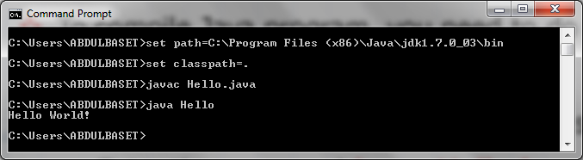
+
//This public
program
prints Hello World!
class
Hello {
public
static
void main(String[]
args) {
System.out.println("Hello World!");
}
}
print a message to the console

Slide 17
+
Analysis of a Java Program
 Comments
 Reserved words
 Modifiers
 Identifiers
 Statements
 Blocks
 Classes
 Methods
 The main method

Slide 18
+
Java Comments
 Java comments can take three forms:
Line comment: is preceded by two slashes (//) in a line
// this comment runs to the end of the line
Paragraph comment: is enclosed between /* and */ in one or multiple lines
/* this comment runs to the terminating
symbol, even across line breaks */
javadoc comment: begins with /** and end with */. They are used for documenting classes, data, and methods.
They can be extracted into an HTML file using JDK's javadoc command
/** this is a javadoc comment */
Comments should be included to explain the purpose of the program and describe processing steps
They do not affect how a program works (compiler ignores comments)

Slide 19
+
Reserved Words
Reserved words or keywords are words that have a specific meaning to the compiler and cannot be used for other purposes in the program. For example, when the compiler sees the word class, it understands that the word after class is the name for the class
We must use reserved words only for their intended purpose.
For example, we can't use the word class for any other purpose than defining a class

Slide 20
+
Reserved Words
 The Java reserved words:
abstract | else | interface | switch
assert | enum | long | synchronized
boolean | extends | native | this
break | false | new | throw
byte | final | null | throws
case | finally | package | transient
catch | float | private | true
char | for | protected | try
class | goto | public | void
const | if | return | volatile
continue default | implements import | short static | while
do | instanceof | strictfp
double | int | super

Slide 21
+
Modifiers
Java uses certain reserved words called modifiers that specify the properties of the data, methods, and classes and how they can be used
Examples of modifiers are public and static. Other modifiers are private, final, abstract, and protected. A public datum, method, or class can be accessed by other programs. A private datum or method cannot be accessed by other programs

Slide 22
+
Identifiers
Identifiers are the words a programmer uses in a program
An identifier consists of alphabetical characters and digits (plus the underscore '_' and the dollar sign '$' characters.
Identifiers can start with a character, '_' or '$' but cannot start with a digit. Digits can be used after the first character (e.g., x1)
No spaces are allowed inside the identifier's name
Java is case sensitive - Total, total, and TOTAL are different identifiers
Cannot be keywords or reserved words
An identifier can be of any length

Slide 23
+
Java Statements
Is a command for the computer to do something. Any statement in Java should be followed by a semicolon ( ; )
Methods are built out of statements.
The statements in a method are placed between braces { and } as in this example
public class Hello {
public static void main ( String[] args )
{
System.out.println("Hello World!");
}
}
There are several types of statements in Java. For example, declaration, assignment, control, and loop statements.

Slide 24
+
Blocks
A pair of curly braces in a program forms a block that groups components of a program
Examples:
o Class block, method block, statement block, ...
public class Hello
{
public static void main (String[] args)
Class block
{
System.out.println("Hello World!");
Method block
}
}

Slide 25
+
Classes
The class is the essential Java construct. It is a template or a blueprint for objects. To program in Java, you need to understand classes and be able to write and use them. The mystery of the class will continue to be unveiled throughout this course. For now, though, understand that a program is defined by using one or more classes
public class
{
………..
Hello
………..
}

Slide 26
+
Methods
What is System.out.println("Hello World!")?
It is a method – a collection of statements that performs a sequence of operations to display a message on the console. It can be used even without fully understanding the details of how it works. It takes a single argument. This argument is enclosed within parentheses. In this case, the argument is of type string "Hello World!"
You can call the same println method with a different argument to print a different message

Slide 27
+
Main Method
The main method provides the control of program flow
The Java interpreter executes the application by invoking the main method
The main method looks like this:
public static
{
void main ( String[] args )
Statement(s);
}

Slide 28
+
Types of Programming Errors
 Syntax (compile-time) error: A grammatical mistake in a program
The compiler can detect these errors, and will output a message saying what it thinks the error is, and where it thinks the error is
Here is the sample program with a deliberate error:
public Class Hello {
public static void main ( String[] args ) {
System.out.println("Hello World!");
public Class Hello {
public static void main ( String[] args ) { System.out.println("Hello World!");
}
}
The reserved word "class" has been changed to "Class" with a capital "C". Here is what happens when the program is compiled:
C:\Temp>javac Hello.java compiling: Hello.java
Hello.java:1: Class or interface declaration expected. Class Hello
^
1 error

Slide 29
+
Types of Programming Errors
 Logic error: A mistake in the underlying algorithm for a program
The compiler cannot detect these errors, and no error message is generated after compilation or during execution, but the program does not do what it is supposed to do
Just because a program compiles and runs does not mean that it is correct. For example, say that your assignment is to create a program that writes "Hello World!" on the computer monitor. But you write the following program.
public class Hello {
public static void main ( String[] args ) { System.out.println( "Hello
Abdulbaset!" );
}
}
public class Hello {
public static void main ( String[] args ) { System.out.println( "Hello Abdulbaset!" );
}
}

Slide 30
+
Basic Program Development
Edit and save program
errors Compile program |  | errors
 | Execute program and evaluate results

Slide 31
+
Good Programming Practice
 Appropriate Comments:
Starts your program with a comment that states the purpose of the program, the author, time and date of the last program modifications
Write a comment before each class, documenting the purpose of the class
Write a comment before each method, documenting the purpose of the method
Write an end of line (single line) comment, documenting the purpose of the statement

Slide 32
+
Good Programming Practice (Cont’d)
 Naming Conventions:
o Choose meaningful and descriptive names helps a program to be self-documenting. Easy to understand
Which code is easier to understand?
Code Sample 1:
float float float
gradeOfExam1 = 90.0;
gradeOfExam2 = 95.0; averageGrades = (gradeOfExam1
+ gradeOfExam2)/2;
Code sample 2:
float float float
asdfghjk = 90.0;
rujflwe = 95.0;
dfiefjek = (asdfghjk + rujflwe)/2;

Slide 33
+
Good Programming Practice (Cont’d)
 Variable and method Naming:
Use lowercase. If the name consists of several words, concatenate all in one, use lowercase for the first word, and capitalize the first letter of each subsequent word in the name. For example, the variable age or myAge, and the method result() or myResult()
 Class Naming:
Capitalize the first letter of each word in the name.
For example, the class name School or MySchool
 Constant Naming:
Capitalize all letters in constants, and use underscores to connect words. For example, the constant PI and MAX_VALUE

Slide 34
+
Good Programming Practice (Cont’d)
 Proper Indentation and Spacing:
Use blank lines to separate segments of the code
Use space characters and code indentations to enhance program readability
Write each statement in a separate line , allowing end of line comment. For example:
System.out.println("Hello World!"); // print a string
In the next slide, which code do you think it is more readable?

Slide 35
+
Good Programming Practice (Cont’d)
Code Sample 1:
public class Test1 {
public static void main ( String[] args ) { System.out.println("On a withered branch");
System.out.println("A crow has just alighted:"); System.out.println("Nightfall in autumn.");
}
}
Code sample 2:
public
class
Test1{ public
{
static
void main(String[] args )
System.out.
println( out.println("A
"On a withered branch"); crow has just alighted:"
in autumn.");
System .
);
System.out.println("Nightfall
}}

Slide 36
+
Good Programming Practice (Cont’d)
 Block Styles:
You may use next-line or end-of-line style for braces
You should stick with one style in the whole code
Next-line style
public class Test
{
public static void main(String[] args)
{
System.out.println("Block Styles");
}
}
End-of-line style
public class Test {
public static void main(String[] args) { System.out.println("Block Styles");
}
}

Slide 37
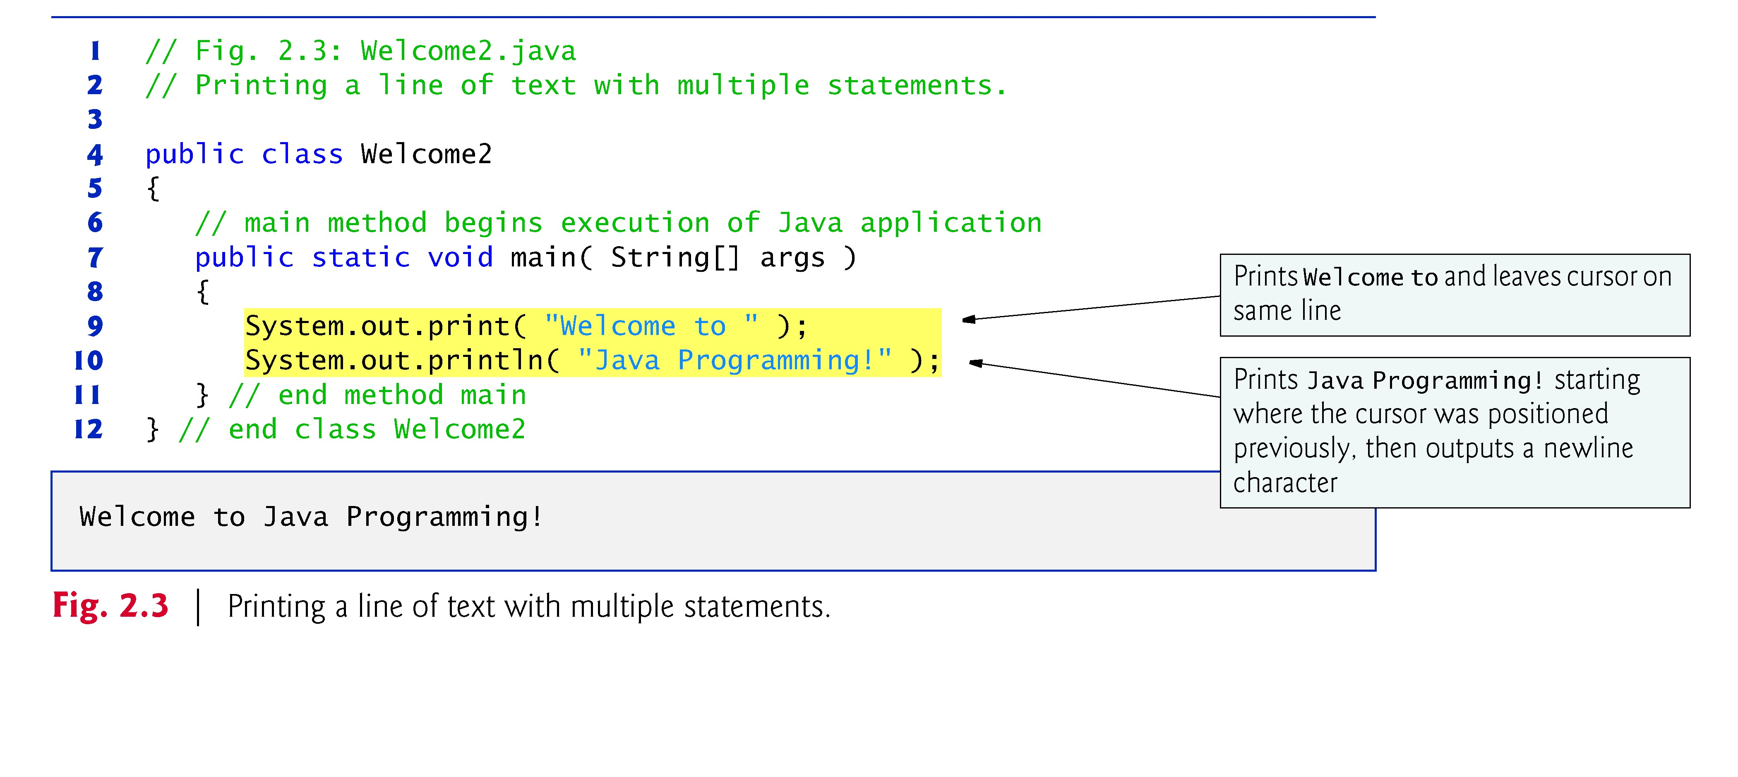
+
Modifying Your First Java Program

Slide 38
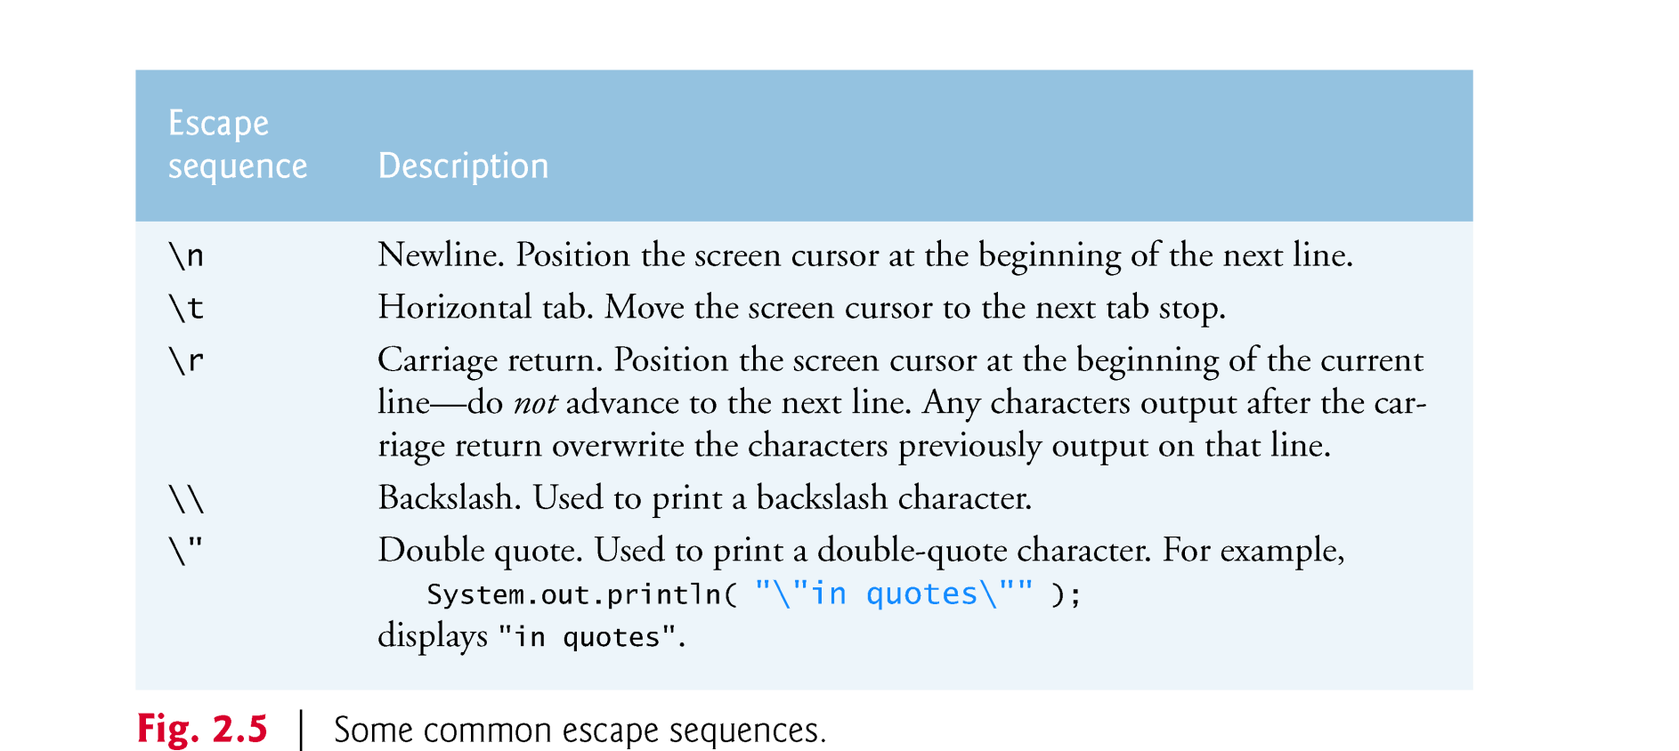
+
Modifying Your First Java Program
Newline characters indicate to System.out’s print and println methods when to position the output cursor at the beginning of the next line in the command window.
The backslash (\) is called an escape character “special character”
Backslash is combined with the next character to form an escape sequence.

Slide 39
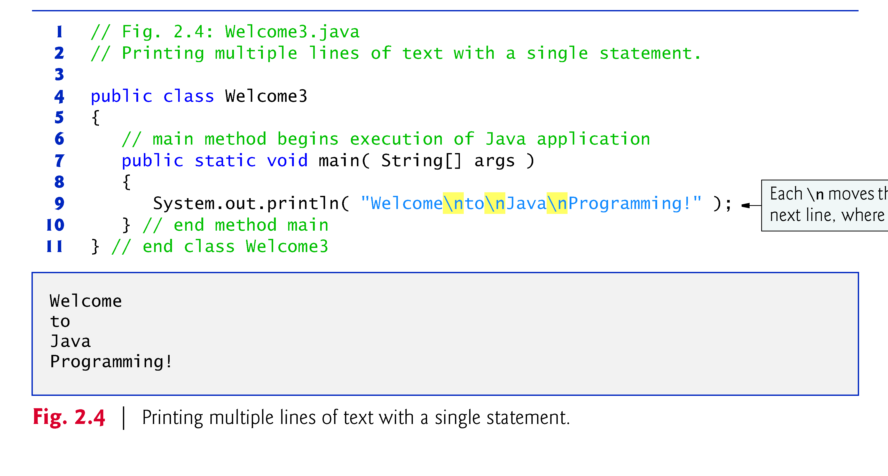
+
Modifying Your First Java Program

Slide 40
+
Data Types
Are the kinds of values that can be stored and manipulated within computer programs
Tell the OS how much memory to allocate, what can be stored in the reserved memory, and what types of operations are allowed
Also enable the Java compiler to check for type compatibility among the expressions and variables.
Java is a strongly typed programming language
Every variable must be declared with a data type
Once it is declared, the data type of the variable cannot change
There are two main data types available in Java:
Primitive date types (the basic, fixed-size types)
Reference date types (the composite types)

Slide 41
+
Primitive Data Types
Are predefined (built-into the language) types that represent a range of values.
They are named by reserved keywords in Java
There are eight primitive data types in Java
Four of them represent integer numbers:
byte, short, int, long
Two of them represent floating point numbers:
float, double
Numeric Data Types
One of them represents characters: char
And one of them represents boolean values:
boolean
Dr. Abdulbaset Gaddah & I. Omniah Nagoor

Slide 42
Primitive Data Types
+
Type Kind of Value Default Size Range
Wrapper
 |  |  |  |  | Class
boolean | true or false | false | 1 bit | NA | Boolean
char | Unicode character | \u0000 | 16 bits | \u0000 to \uFFFF | Character
byte | Signed integer | 0 | 8 bits | -128 to 127 | Byte
short | Signed integer | 0 | 16 bits | -32768 to 32767 | Short
int | Signed integer | 0 | _{32 bits} -2147483648 to _{Integer} 2147483647
long | Signed integer | 0 | _{64 bits} -9223372036854775808 to _{Long} 9223372036854775807
float | floating point | 0.0 | 32 bits ^{±1.4E-45 to} Float ±3.4028235E+38
double | floating point | 0.0 | 64 bits ^{±4.9E-324 to} Double
Dr. Abdulba
set Gaddah & I. Omniah Nagoor
±1.7976931348623157E+308

Slide 43
+
Variable Declaration
 Variable – a location in main memory that holds one value of a particular data type at a time, but that value can change
Must be declared with a name and a type before they can be used
A variable’s name enables the program to access the value of the variable in memory. It can be any valid identifier
A variable’s type specifies what type of information is stored at that location in memory . It can be one of the primitive data types
Once a variable is declared, its data type cannot change
The type of the variable is followed by one or more variable names separated by commas (,) and terminated with a semicolon (;)
Syntax: Data_Type Variable_Name;
Examples: double radius;
double area;
OR
double radius, area;

Slide 44
+
Assignment Statements
In Java, the assignment statement is used to change the value of a variable
The equal sign (=) is used as the assignment operator
An assignment statement consists of a variable on the left side of the (=) operator, and an expression on the right side of the (=) operator
Syntax: Variable_Name = Expression;
Example: area = radius * radius * PI;
An expression may consist of a variable, number, or mix of variables, numbers, operators, and/or method invocations
Other Examples:
radius = 20;
radius = newRadius;
radius = 1.2 * getCurrentRadius();

Slide 45
+
Assignment Statements (Cont’d)
When an assignment statement is executed, the expression is first evaluated, and then the variable on the left-hand side of the equal sign is set equal to the value of the expression
area = radius * radius * PI;
The compiler always checks the type compatibility of the used variables and expressions
The same variable can occur on both sides of the assignment operator count = count + 1;
The assignment operator is automatically executed from right-to- left, so assignment statements can be chained
var3 = var2 = var1 = 3;

Slide 46
+
Variable Initialization
A variable that has been declared but that has not yet been given a value by some means is said to be uninitialized
In certain cases, the Java compiler gives a default value to an uninitialized variable based on its data type (see slide #53)
It is best not to rely on this
Explicitly initialized variables improves program clarity
In some cases, variables must be given initial values
E.g., if we try to use a variable without first giving it an initial value:
int numberOfDays;
numberOfDays = numberOfDays + 10;
The Java compiler will throw an error:
variable numberOfDays might not have been initialized

Slide 47
+
Variable Initialization (Cont’d)
 Variable declaration and initialization can be achieved in one step via an assignment statement
int number = long max = x | 223; + 1; |  | boolean b = true; double distance =55 * 0.5;
char grade = | 'A'; | OR | char grade ='\u0041';
Note that some variables can be initialized and others can remain uninitialized in the same declaration
int initialCount = 5, finalCount, anotherCount = 10;
OR
int initialCount = 5, finalCount,
anotherCount = 10;
int x1 = 0, int x2, double x3 = 1.0; // error

Slide 48
+
Reference Book
Java How to Program, 9/e

Slide 49

+
Any Questions??

